Slide 1
Reedy Creek
is launching BYOD!

Slide 2
B.y.o.d
Bring Your own Device

Slide 3
What is BYOD?
A way to increase student access to technology by leveraging student devices in the classroom.

Slide 4
BYOD
Students will be able to bring their device and use them during lessons in GREEN ZONES only.
Green Zones will be designated by
signs outside of classroom doors.

Slide 5
Students will not be able to use their devices in RED ZONES.
Red Zones include:
Cafeteria
Hallways
Locker Rooms
Bathrooms
Classroom if RED ZONE sign is
put up outside the door.

Slide 6
To participate in BYOD… Students must have the BYOD contract signed by their parent/guardian on file at school.

Slide 7
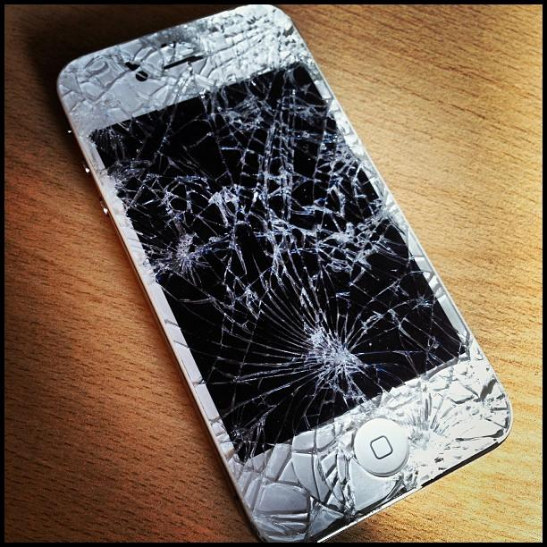
Students are responsible for their own devices
Students may NOT share devices.
Students need to bring their device to school. They will not be accepted in the office if brought during the day.
The school is not responsible for lost, stolen or damaged devices.

Slide 8
Devices are for educational purposes only
Students should only access files and
visit sites related to classroom curriculum.
Devices should NOT be used for taking or sending photos and/or videos.
Students should NOT access social media, personal email or texting.

Slide 9
Follow acceptable use policy
Students may not use devices during Tests/Exams.
Students must be on the WCPSS BYOD WiFi Network while in use (not a mobile data network).
Students must comply with Wake County Public School’s Acceptable Use Policy for Electronic Devices.

Slide 10
Noncompliance with byod rules
First Offense | Verbal warning from teacher.
Second Offense | Student must put their device in their locker. Parent will be notified.
Third Offense | Immediate referral to administration. Parents can pick up device from school.
Repeated Offenses | At administrative discretion, the student may lose BYOD privileges in all classes and may not be allowed to bring their device to school.

Slide 11
Devices in red zones
First Offense:
Device will be confiscated.
Student can pick up at the end of the school day.
Second Offense:
Device will be taken and turned into the office.
Parents can pick up device from school.
Third Offense:
Administrative Referral

Slide 12
BYOD night!!
Parents and students are invited to join us for Curriculum Night on Thursday, September 15th where we will talk about BYOD!
After this, BYOD will officially kick off at RCMMS!

Slide 13
THANKS!
Let’s make BYOD great!

